Slide 1
BIG DATA TECHNOLOGY APPLICATION
1- SENTIMENT ANALYSIS ON STREAM OF TWEETS
2- APPLICATION OF KAFKA
By ROMUALD POGO KAMOU

Slide 2
1- SENTIMENT ANALYSIS ON STREAM OF TWEETS

Slide 3
ALGORITHM APPLIED ON BATCH OF TWEETS
Begin
Catalog_word <– load(file_catalog_word_sentiment.txt)
Batch_tweets <- TwitterStreamUtil.fetchTweets(time_interval)
Filter_tweets <- Batch_tweets .filter(Key_Words_Subject)
ForEach(tweet of Filter_tweets ){
listWordCount <- wordcount(tweet)
ForEach(<word, count> of listWordCount){
Sentiment_value += Catalog_word (word).sentiment ^ count
}
HBaseUtil.save(sentiment_value)
}
end

Slide 4
TECHNOLOGIES

Slide 5
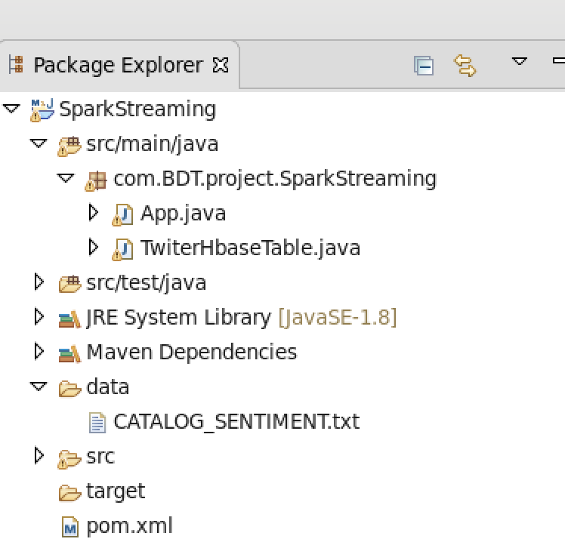
APPLICATION SOURCE CODE

Slide 6
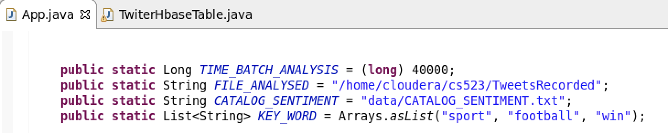
APPLICATION SOURCE CODE contd…
Constant variable unique for each analysis

Slide 7
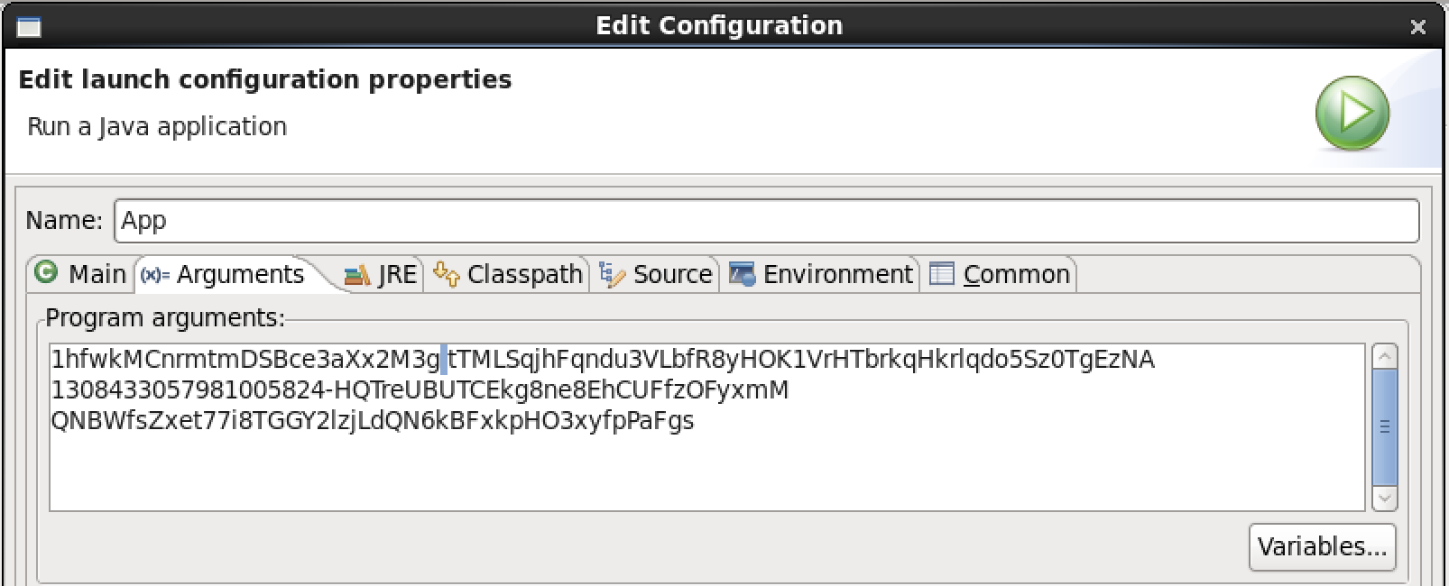
APPLICATION SOURCE CODE contd…
Runtime parameters : twitter credentials
consumerKey consumerSecret
accessToken accessTokenSecret

Slide 8
2- APPLICATION OF

Slide 9
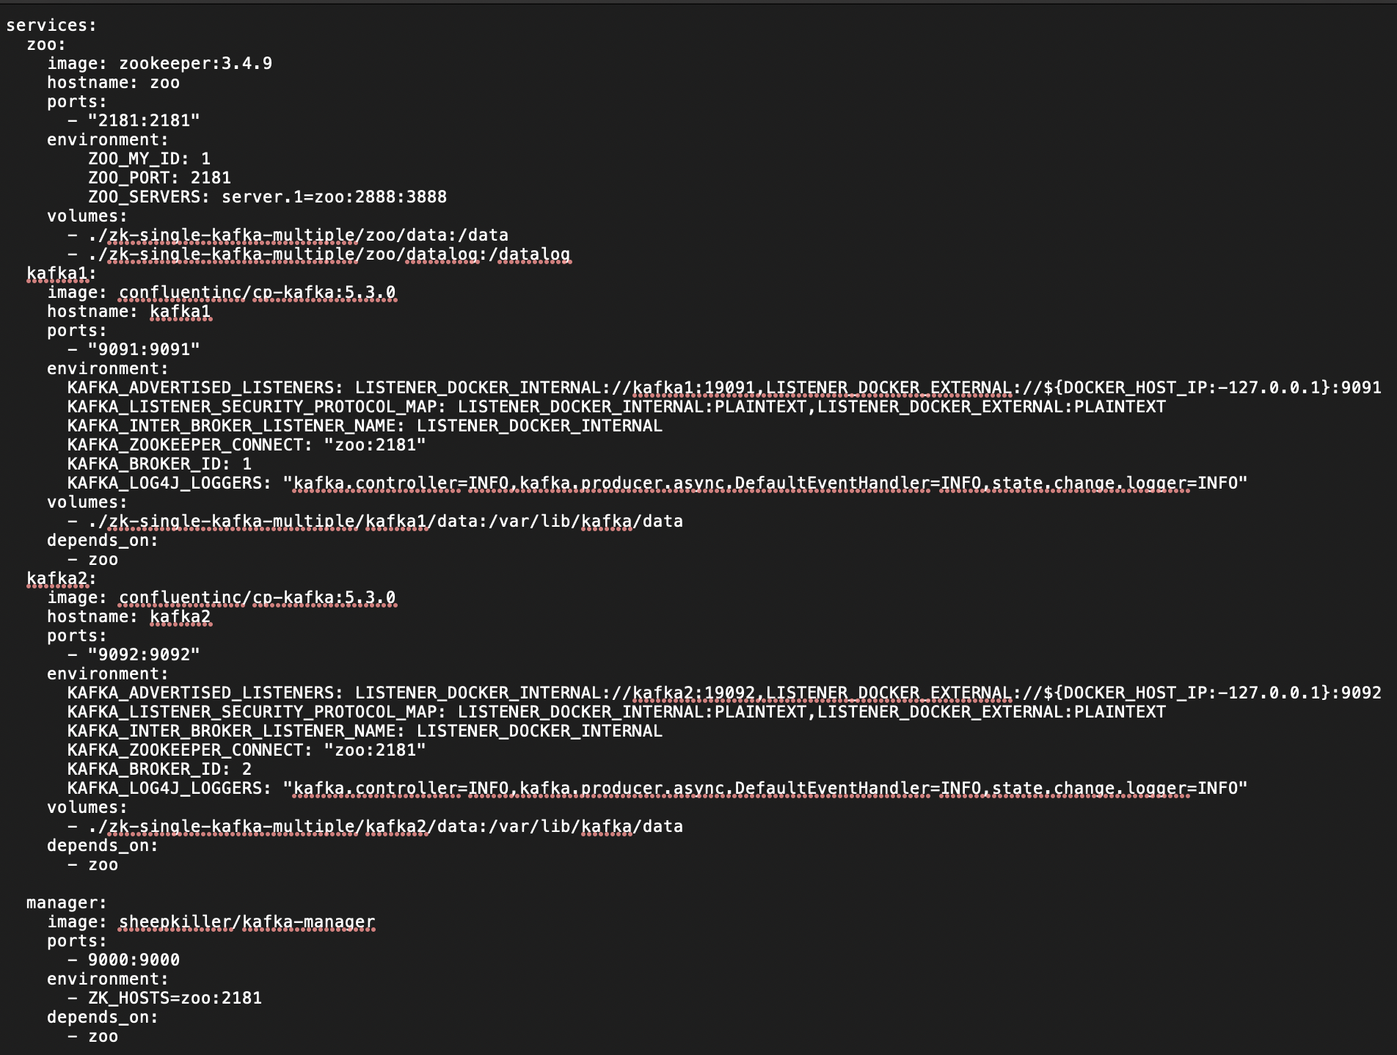
CONFIGURATION KAFKA IN DOCKER CONTAINER
Save this config in docker-composer.yml
Run on a terminal :
docker-composer up

Slide 10
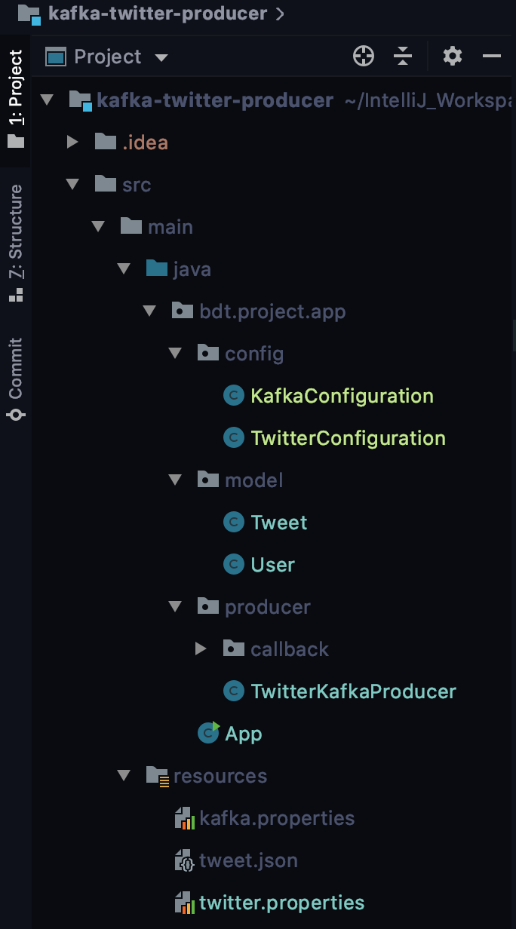
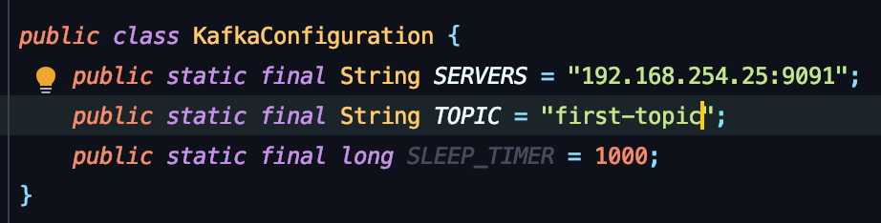
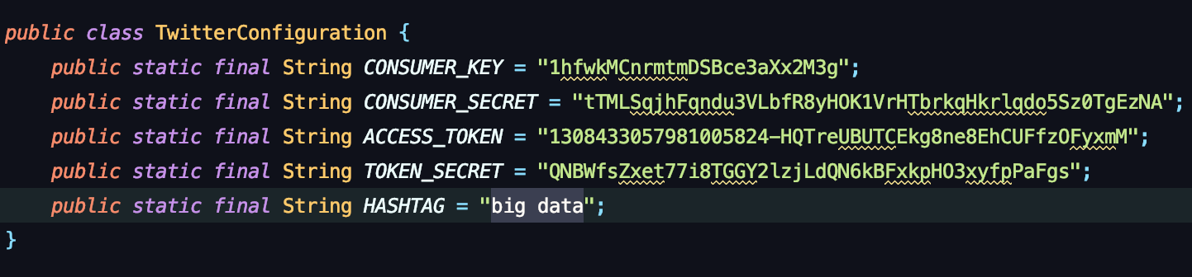
KAFKA PRODUCER

Slide 11
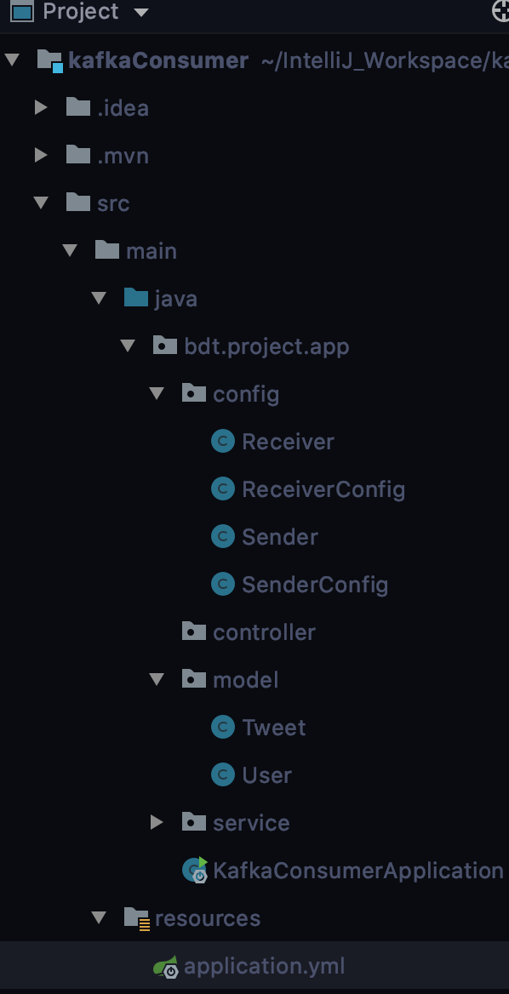
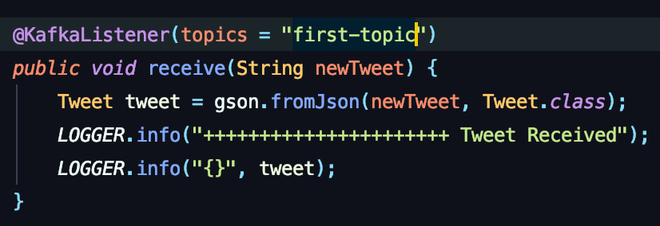
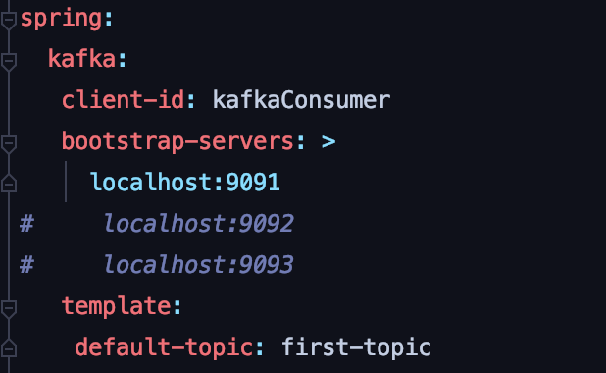
KAFKA CONSUMER

